Slide 1
HTML(HYPER TEXT MARKUP LANGUAGE)

Slide 2
HTML Introduction
HTML is the standard markup language for creating Web pages.
HTML stands for Hyper Text Markup Language
HTML is the standard markup language for creating Web pages
HTML describes the structure of a Web page
HTML consists of a series of elements
HTML elements tell the browser how to display the content
HTML elements label pieces of content such as "this is a heading", "this is a paragraph", "this is a link", etc.

Slide 3
HTML History
Year | Version
1989 | Tim Berners-Lee invented www
1991 | Tim Berners-Lee invented HTML
1993 | Dave Raggett drafted HTML+
1995 | HTML Working Group defined HTML 2.0
1997 | W3C Recommendation: HTML 3.2
1999 | W3C Recommendation: HTML 4.01
2000 | W3C Recommendation: XHTML 1.0
2008 | WHATWG HTML5 First Public Draft
2012 | WHATWG HTML5 Living Standard
2014 | W3C Recommendation: HTML5
2016 | W3C Candidate Recommendation: HTML 5.1
2017 | W3C Recommendation: HTML5.1 2nd Edition
2017 | W3C Recommendation: HTML5.2

Slide 4
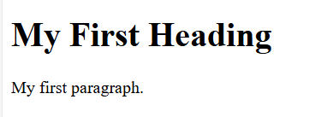
A Simple HTML Document
Example:
Code:
<!DOCTYPE html>
<html>
<head>
<title>Page Title</title>
</head>
<body>
<h1>My First Heading</h1>
<p>My first paragraph.</p>
</body>
</html>
Output:

Slide 5
About Code
The <!DOCTYPE html> declaration defines that this document is an HTML5 document
The <html> element is the root element of an HTML page
The <head> element contains meta information about the HTML page
The <title> element specifies a title for the HTML page (which is shown in the browser's title bar or in the page's tab)
The <body> element defines the document's body, and is a container for all the visible contents, such as headings, paragraphs, images, hyperlinks, tables, lists, etc.
The <h1> element defines a large heading
The <p> element defines a paragraph

Slide 6
What is HTML5
HTML5 is the fifth version of Hypertext Markup Language (HTML), a standard language used to structure webpages. It defines how content on a webpage should be structured and displayed. Here are some key points of HTML5.
Provides multimedia support by embedding audio and video without plugins.
Adds new form controls like date and email input types.
Enables web storage to store data offline for better performance.
Uses semantic elements such as <header> and <footer> for clearer structure.
Delivers improved performance, especially on mobile devices.

Slide 7
<html> Element
The lang attribute specifies the language of the HTML document.
It is added to the <html> tag.
It helps browsers display the content correctly.
It helps search engines understand the language of the webpage.
It improves accessibility for screen readers and assistive technologies.
Different language codes can be used, such as:
  en → English
  fr → French
  es → Spanish
  hi → Hindi
  pa → Punjabi
<html lang="en">

Slide 8
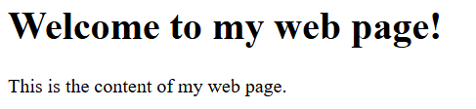
<head> element
Code:
<!DOCTYPE html>
<html>
<head>
<title>My Web Page</title>
<meta charset="UTF-8">
<link rel="stylesheet" href="styles.css">
<script src="script.js"></script>
</head>
<body>
<h1>Welcome to my web page!</h1>
<p>This is the content of my web page.</p>
</body>
</html>
Output:

Slide 9
<head> element
the <head> element contains several elements that provide metadata about the document:
<title>: This element specifies the title of the web page, which appears in the browser's title bar and is used by search engines to index the page.
<meta>: This element provides information about the character set used in the document. In this example, the charset attribute specifies that the document is encoded using UTF-8.
<link>: This element specifies the location of an external stylesheet that is used to define the visual style of the web page.
<script>: This element specifies the location of an external JavaScript file that is used to add interactivity to the web page.

Slide 10
<body> element
The <body> element contains all the visible content of a webpage.
It is the main container for the content displayed in a web browser.
It appears after the <head> element in an HTML document.
The <head> element stores metadata, title, links, and scripts, which are not directly visible on the webpage.
The browser renders everything inside the <body> tag.
The <body> can contain:
  Headings (<h1> to <h6>)
  Paragraphs (<p>)
  Images (<img>)
  Videos (<video>)
  Links (<a>)
  Lists (<ul>, <ol>)
  Tables (<table>)
  Forms (<form>)
  Buttons (<button>)
  Other HTML elements

Slide 11
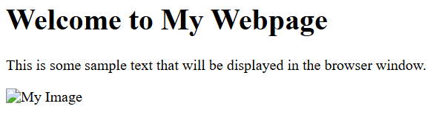
<body> element
Code:
<!DOCTYPE html>
<html>
<head>
<title>My Webpage</title>
</head>
<body>
<h1>Welcome to My Webpage</h1>
<p>This is some sample text that will be displayed in the browser window.</p>
<img src="myimage.jpg" alt="My Image">
</body>
</html>
Output:

Slide 12
The Opening and the Closing Tags
An HTML element is usually made up of:
  Opening (Start) Tag
  Content
  Closing (End) Tag
The opening tag starts with < and ends with >.
The opening tag contains the name of the HTML element.
The content is the information displayed between the opening and closing tags.
The closing tag is similar to the opening tag but includes a forward slash (/) before the element name.
<p>This is a paragraph.</p>

Slide 13
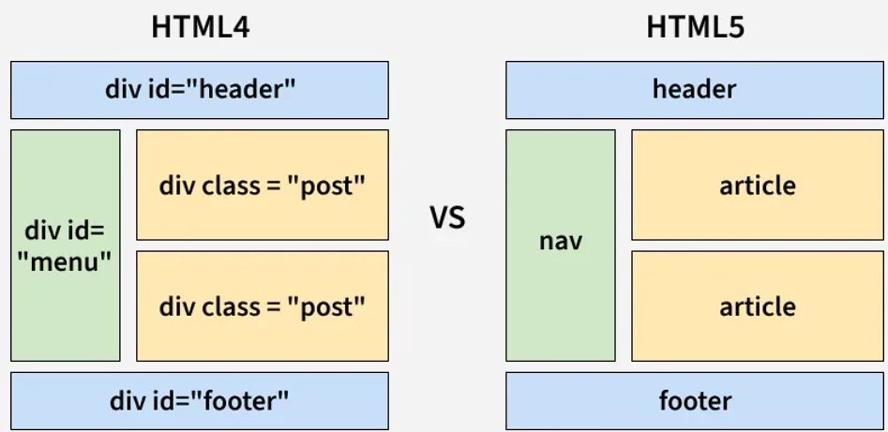
HTML4 VS HTML5

Slide 14
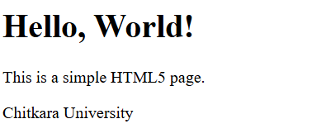
Example of HTML5
Code:
<html>
<head>
<meta charset="UTF-8">
<meta name="viewport" content="width=device-width, initial-scale=1.0">
<title>Simple HTML Page</title>
</head>
<body>
<header>
<h1>Hello, World!</h1>
</header>
<main>
<p>This is a simple HTML5 page.</p>
</main>
<footer>
<p>Chitkara University</p>
</footer>
</body>
</html>
Output:

Slide 15
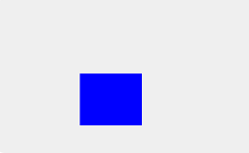
Example of HTML5
Using the <canvas> Element for Drawing
Code:
<html>
<body>
<canvas id="myCanvas" width="100" height="100"></canvas>
<script>
var canvas = document.getElementById("myCanvas");
var ctx = canvas.getContext("2d");
ctx.fillStyle = "blue";
ctx.fillRect(50, 50, 100, 100);
</script>
</body>
</html>
Output:

Slide 16
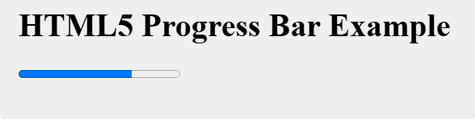
Example of HTML5
Using the <progress> Element to Show Task Progress
Code:
<html>
<body>
<h1>HTML5 Progress Bar Example</h1>
<progress value="70" max="100"></progress>
</body>
</html>
Output:

Slide 17
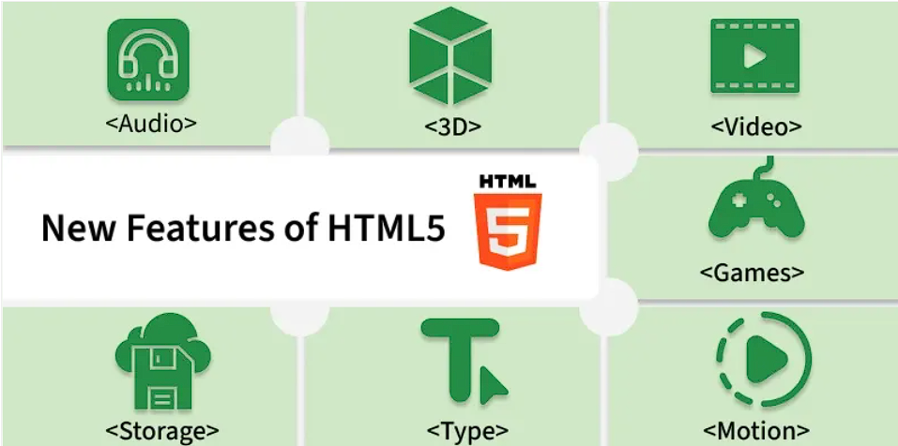
Features of HTML5

Slide 18
New Added Elements in HTML 5
<article>: The <article> tag represents independent, self-contained content like articles or posts.
<aside>: The <aside> tag holds secondary or related information supporting the main content.
<figcaption>: The <figcaption> tag provides a caption or description for a <figure> element.
<figure>: The <figure> tag groups self-contained media such as images, diagrams, or code.
<header>: The <header> tag contains introductory content like headings or navigation links.
<footer>: The <footer> tag includes closing content such as author info or copyright notes.
<main>: The <main> tag defines the central, most important content of the webpage.
<mark>: The <mark> tag highlights or emphasizes specific text.
<nav>: The <nav> tag groups navigation links for moving around the site.
<section>: The <section> tag organizes related content into thematic blocks.

Slide 19
New Added Elements in HTML 5
<details>: The <details> tag creates expandable or collapsible content sections.
<summary>: The <summary> tag provides the clickable heading for a <details> element.
<time>: The <time> tag represents dates or times in a readable and machine-usable format.
<bdi>: The <bdi> tag isolates text with unknown or mixed text direction.
<wbr>: The <wbr> tag adds an optional line-break position in long words.
<datalist>: The <datalist> tag provides autocomplete suggestions for an <input> element.
<keygen>: The <keygen> tag generates key pairs for secure authentication (deprecated).
<output>: The <output> tag displays results of calculations or script actions.
<progress>: The <progress> tag visually represents the progress of a task.
<svg>: The <svg> tag embeds scalable vector graphics into a webpage.
<canvas>: The <canvas> tag draws dynamic graphics using JavaScript.

Slide 20
New Added Elements in HTML 5
<audio>: The <audio> tag embeds audio content like music or sound effects.
<embed>: The <embed> tag inserts external resources such as media players or apps.
<source>: The <source> tag defines media sources for <audio> and <video> elements.
<track>:The <track> tag provides captions or subtitles for videos.
<video>: The <video> tag embeds video content directly into a webpage.

Slide 21
HTML5 Advantages
HTML5 offers several benefits that enhance modern web development like:
Works on all major browsers and devices (cross-platform).
Lets websites access user location (geolocation).
Supports offline use through Web Storage or AppCache.
Uses semantic tags for cleaner, simpler code.
Optimized for smooth performance on mobile devices.

Slide 22
HTML5 Disadvantages
Despite its strengths, HTML5 comes with some drawbacks:
Older browsers may not support all HTML5 features (browser inconsistencies).
Some older mobile devices struggle with HTML5 (mobile compatibility issues).
Web Storage and similar features can pose security risks if misused.
Advanced APIs introduce complexity for beginners.
IE 8 and below show poor support for HTML5.

Slide 23
What are Semantic Elements?
A semantic element clearly describes its meaning to both the browser and the developer.
Examples of non-semantic elements: <div> and <span> - Tells nothing about its content.
Examples of semantic elements: <img>, <table>, and <article> - Clearly defines its content.

Slide 24
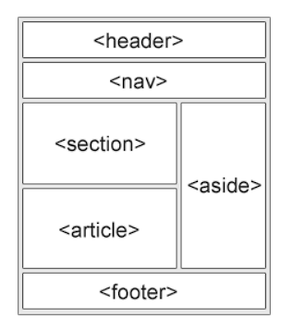
Semantic Elements in HTML
<article>
<aside>
<details>
<figcaption>
<figure>
<footer>
<header>
<main>
<mark>
<nav>
<section>
<summary>
<time>

Slide 25
HTML <section> Element
The <section> element defines a section in a document.
Examples of where a <section> element can be used:
Chapters
Introduction
News items
Contact information

Slide 26
Example
Two sections in a document:
CODE:
<section>
<h1>WWF</h1>
<p>The World Wide Fund for Nature (WWF) is an international organization working on issues regarding the conservation, research and restoration of the environment, formerly named the World Wildlife Fund. WWF was founded in 1961.</p>
</section>
<section>
<h1>WWF's Panda symbol</h1>
<p>The Panda has become the symbol of WWF. The well-known panda logo of WWF originated from a panda named Chi Chi that was transferred from the Beijing Zoo to the London Zoo in the same year of the establishment of WWF.</p>
</section>

Slide 27
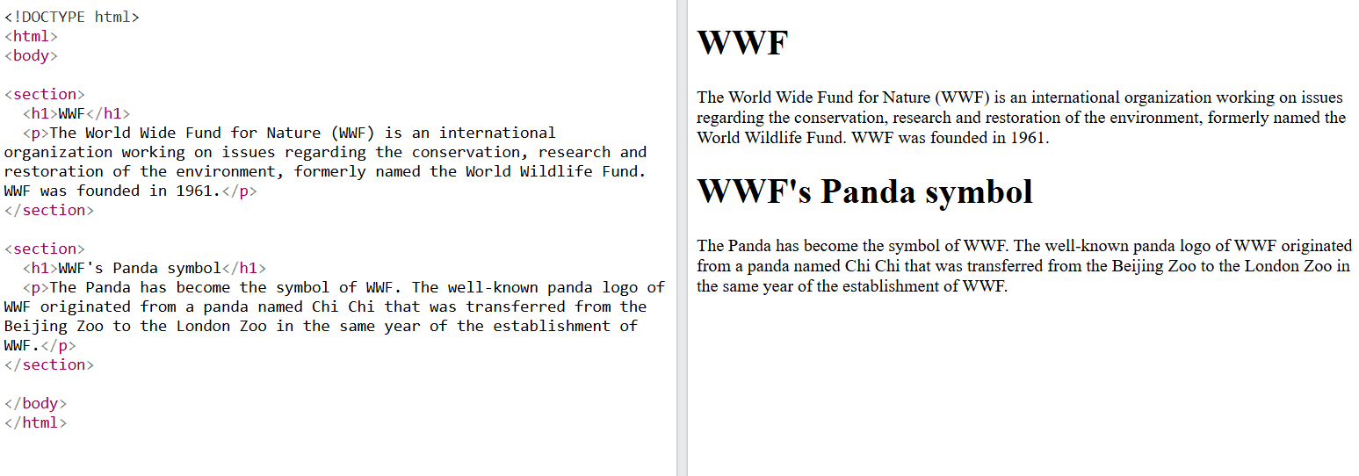
Output
Code:
<!DOCTYPE html>
<html>
<head>
<title>Section Example</title>
</head>
<body>
<section>
<h1>WWF</h1>
<p>
The World Wide Fund for Nature (WWF) is an international
organization working on issues regarding the conservation,
research and restoration of the environment, formerly named
the World Wildlife Fund. WWF was founded in 1961.
</p>
</section>
<section>
<h1>WWF's Panda symbol</h1>
<p>
The Panda has become the symbol of WWF. The well-known panda
logo of WWF originated from a panda named Chi Chi that was
transferred from the Beijing Zoo to the London Zoo in the same
year of the establishment of WWF.
</p>
</section>
</body>
</html>
Output:

Slide 28
HTML <article> Element
The <article> element defines independent, self-contained content.
The content inside an <article> should make sense on its own.
An <article> can be shared or distributed independently from the rest of the webpage.
It is commonly used for content that can stand alone.
Examples of <article> content:
Forum posts
Blog posts
User comments
Product cards
Newspaper or magazine articles
News stories

Slide 29
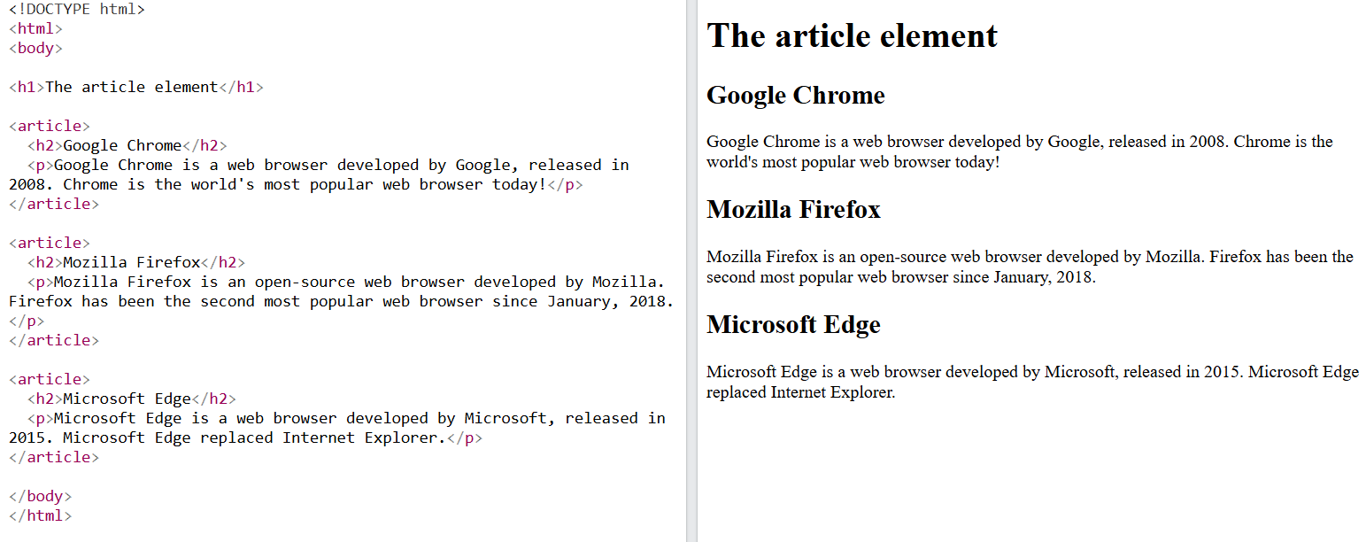
Code
<!DOCTYPE html>
<html>
<head>
<title>Article Example</title>
</head>
<body>
<h1>The article element</h1>
<article>
<h2>Google Chrome</h2>
<p>
Google Chrome is a web browser developed by Google, released in
2008. Chrome is the world's most popular web browser today!
</p>
</article>
<article>
<h2>Mozilla Firefox</h2>
<p>
Mozilla Firefox is an open-source web browser developed by Mozilla.
Firefox has been the second most popular web browser since January, 2018.
</p>
</article>
<article>
<h2>Microsoft Edge</h2>
<p>
Microsoft Edge is a web browser developed by Microsoft, released in
2015. Microsoft Edge replaced Internet Explorer.
</p>
</article>
</body>
</html>
Output:

Slide 30
Nesting <article> in <section>
The <article> element specifies independent, self-contained content.
The <section> element defines a section in a document.

Slide 31
HTML <header> Element
The <header> element represents a container for introductory content or a set of navigational links.
A <header> element typically contains:
one or more heading elements (<h1> - <h6>)
logo or icon
authorship information
Note: You can have several <header> elements in one HTML document. However, <header> cannot be placed within a <footer>, <address> or another <header> element.

Slide 32
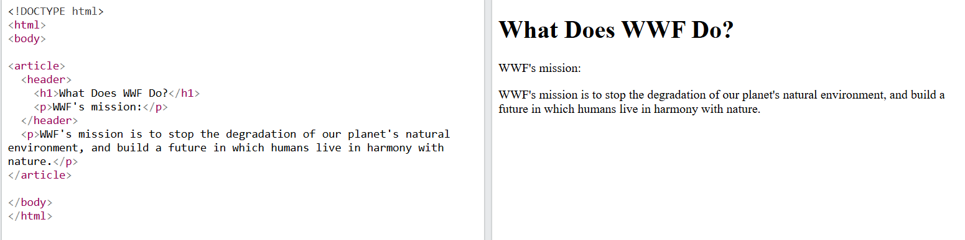
Example
Code:
<!DOCTYPE html>
<html>
<head>
<title>Header Example</title>
</head>
<body>
<article>
<header>
<h1>What Does WWF Do?</h1>
<p>WWF's mission:</p>
</header>
<p>
WWF's mission is to stop the degradation of our planet's natural
environment, and build a future in which humans live in harmony
with nature.
</p>
</article>
</body>
</html>
Output:

Slide 33
HTML <footer> Element
The <footer> element defines a footer for a document or section.
A <footer> element typically contains:
authorship information
copyright information
contact information
sitemap
back to top links
related documents

Slide 34
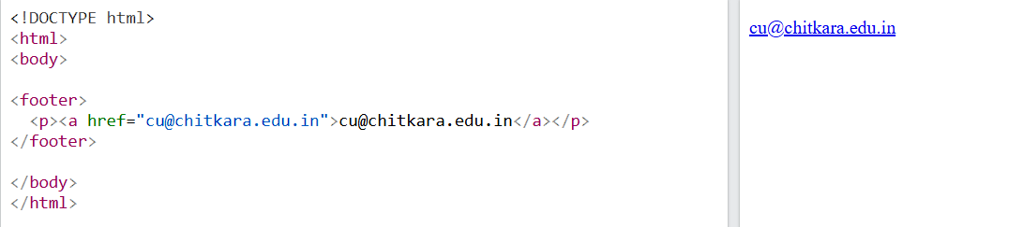
Example
Code
<!DOCTYPE html>
<html>
<body>
<footer>
<p>
<a href="mailto:cu@chitkara.edu.in">
cu@chitkara.edu.in
</a>
</p>
</footer>
</body>
</html>
Output

Slide 35
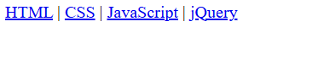
HTML <nav> Element
The <nav> element defines a set of navigation links.
Code
<!DOCTYPE html> Output:
<html>
<body>
<nav>
<a href="/html/">HTML</a> |
<a href="/css/">CSS</a> |
<a href="/js/">JavaScript</a> |
<a href="/jquery/">jQuery</a>
</nav>
</body>
</html>

Slide 36
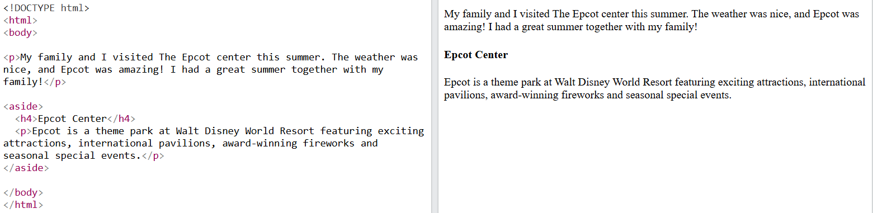
HTML <aside> Element
The <aside> element defines some content aside from the content it is placed in (like a sidebar).
The <aside> content should be indirectly related to the surrounding content.
Example
<!DOCTYPE html><html> Output:
<body>
<p>
My family and I visited The Epcot center this summer.
The weather was nice, and Epcot was amazing!
I had a great summer together with my family!
</p>
<aside>
<h4>Epcot Center</h4>
<p>
Epcot is a theme park at Walt Disney World Resort
featuring exciting attractions, international
pavilions, award-winning fireworks and seasonal
special events.
</p>
</aside>
</body>
</html>

Slide 37
HTML <figure> and <figcaption> Elements
The <figure> tag specifies self-contained content, like illustrations, diagrams, photos, code listings, etc.
The <figcaption> tag defines a caption for a <figure> element. The <figcaption> element can be placed as the first or as the last child of a <figure> element.
The <img> element defines the actual image/illustration.

Slide 38
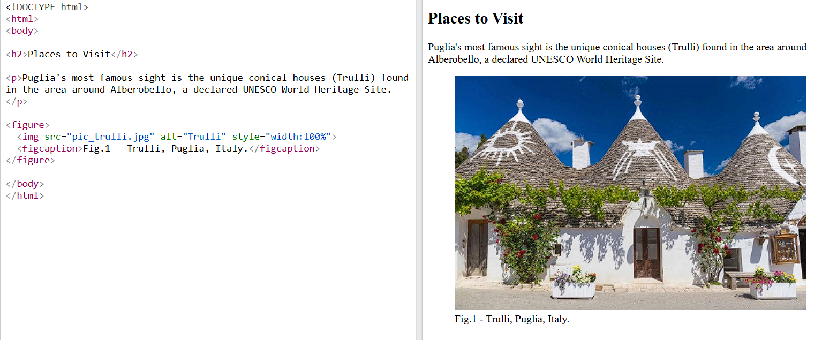
Example
Code:
<!DOCTYPE html>
<html>
<body>
<h2>Places to Visit</h2>
<p>
Puglia's most famous sight is the unique conical houses (Trulli)
found in the area around Alberobello, a declared UNESCO World
Heritage Site.
</p>
<figure>
<img src="pic_trulli.jpg" alt="Trulli" style="width:100%">
<figcaption>Fig.1 - Trulli, Puglia, Italy.</figcaption>
</figure>
</body>
</html>
Output:

Slide 39
More Semantic Elements
<article> | Defines independent, self-contained content
<aside> | Defines content aside from the page content
<details> | Defines additional details that the user can view or hide
<figcaption> | Defines a caption for a <figure> element
<figure> | Specifies self-contained content, like illustrations, diagrams, photos, code listings, etc.
<footer> | Defines a footer for a document or section
<header> | Specifies a header for a document or section
<main> | Specifies the main content of a document
<mark> | Defines marked/highlighted text
<nav> | Defines navigation links
<section> | Defines a section in a document
<summary> | Defines a visible heading for a <details> element
<time> | Defines a date/time

Slide 40
What are Non Semantic Elements?
Unlike, semantic elements they don't have any meaning. They don't tell anything about the content they contain. They can be used with different attributes to mark up semantics common to a group.
Following is the list of some non-semantic elements:
div
span

Slide 41
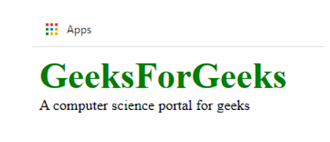
Example
Example shows the use of non-semantic elements.
Code:
<!DOCTYPE html>
<html>
<head>
<title>my web page</title>
<style type="text/css">
span {
color: green;
font-size: 40px;
font-weight: bold;
}
</style>
</head>
<body>
<div>
<span>GeeksForGeeks</span> <br>
A computer science portal for geeks
</div>
</body>
</html>
Output:

Slide 42
Difference between semantic and non-semantic elements
Semantic elements | Non-Semantic elements
They have meaning | They don't have meaning
They describe how the content within them is supposed to behave | They can contain anything
They have specific attributes for their structure | The 'class' attribute can be used to work with their structure

Slide 43
HTML Links - Hyperlinks
HTML links are hyperlinks.
Note: A link does not have to be text. A link can be an image or any other HTML element!
Syntax:
<a href="url">link text</a>
The most important attribute of the <a> element is the href attribute, which indicates the link's destination.
The link text is the part that will be visible to the reader.
Clicking on the link text, will send the reader to the specified URL address.

Slide 44
HTML Links - The target Attribute
The target attribute specifies where to open the linked document.
The target attribute can have one of the following values:
_self - Default. Opens the document in the same window/tab as it was clicked
_blank - Opens the document in a new window or tab
_parent - Opens the document in the parent frame
_top - Opens the document in the full body of the window
Example:
<a href="https://www.w3schools.com/" target="_blank">Visit W3Schools!</a>

Slide 45
Absolute URLs vs. Relative URLs
Example:
<h2>Absolute URLs</h2>
<p><a href="https://www.w3.org/">W3C</a></p>
<p><a href="https://www.google.com/">Google</a></p>
<h2>Relative URLs</h2>
<p><a href="html_images.asp">HTML Images</a></p>
<p><a href="/css/default.asp">CSS Tutorial</a></p>

Slide 46
Button as a Link
To use an HTML button as a link, you have to add some JavaScript code.
JavaScript allows you to specify what happens at certain events, such as a click of a button:
Example:
<button onclick="document.location='default.asp'">HTML Tutorial</button>

Slide 47
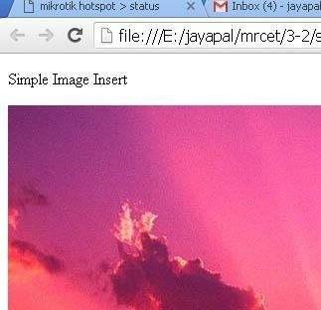
Tags in HTML – Image tag
IMAGES
<img> tag
The HTML <img> tag is used to embed an image in a web page.
Closing tags are not used in HTML image element.
The <img> tag has two required attributes:
  src - Specifies the path to the image
  alt - Specifies an alternate text for the image
Insert Image :
we can insert any image in web page by using <img> tag.
  Syntax:
  <img src = "Image URL" attributes-list>
  Ex.:
  <img src="C:\Users\Pictures\flowe.jpeg" alt=“A pixabay flower">

Slide 48

Tags in HTML – Image tag(Size)
IMAGES:
Set Image Width/Height
<img src = "/html/images/test.png" alt = "Test Image" width = "150" height = "100"/>
<html>
<body>
<h2>Image Size</h2>
<img src=“flower.jpg" alt=“A Pixabay flower” width="500" height="600">
</body>
</html>

Slide 49
Tags in HTML – Image tag (Alignment)
IMAGES
IMAGE ALIGNMENT
The align attribute specifies the horizontal and vertical alignment of the image in relation to the surrounding text/elements.
Example
<img src = "test.png" alt = "Test Image"align = "right"/>
Value | Description
left | Align the image to the left
right | Align the image to the right
top | Align the image on the top
bottom | Align the image on the bottom
Middle | Align the image on the middle

Slide 50
Tags in HTML – Image tag (Borders)
IMAGES:
SET IMAGE BORDER:
The <img> border attribute is used to specify the border width around the image.
The default value of <img> border attribute is 0.
It is not supported by HTML 5. Use CSS instead of this attribute
<img src = "test.png" alt = "Test Image" border = "3"/>

Slide 51
The src Attribute
The src (source) attribute specifies the path (URL) of the image.
It is a required attribute of the <img> tag.
The browser uses the src attribute to locate and display the image.
The image file should remain in the correct location relative to the HTML file.
If the image path is incorrect or the image is missing, the browser displays a broken image icon.
When the image cannot be loaded, the alt text is displayed instead.
The src attribute can contain:
  Relative URL (e.g., images/photo.jpg)
  Absolute URL (e.g., https://example.com/photo.jpg)
Syntax:
<img src="img_chania.jpg" alt="Flowers in Chania">

Slide 52
The alt Attribute
The required alt attribute provides an alternate text for an image, if the user for some reason cannot view it (because of slow connection, an error in the src attribute, or if the user uses a screen reader).
The value of the alt attribute should describe the image:
Syntax:
<img src="img_chania.jpg" alt="Flowers in Chania">

Slide 53
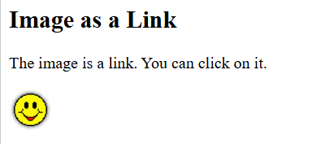
Image as a Link
To use an image as a link, put the <img> tag inside the <a> tag:
<!DOCTYPE html>
<html>
<body>
<h2>Image as a Link</h2>
<p>The image is a link. You can click on it.</p>
<a href="default.asp">
<img src="smiley.gif" alt="HTML tutorial" style="width:42px;height:42px;">
</a>
</body>
</html>
Output:

Slide 54
Common Image Formats
Abbreviation | File Format | File Extension
APNG | Animated Portable Network Graphics | .apng
GIF | Graphics Interchange Format | .gif
ICO | Microsoft Icon | .ico, .cur
JPEG | Joint Photographic Expert Group image | .jpg, .jpeg, .jfif, .pjpeg, .pjp
PNG | Portable Network Graphics | .png
SVG | Scalable Vector Graphics | .svg

Slide 55
HTML Tables
HTML tables allow web developers to arrange data into rows and columns.
Company | Contact | Country
Alfreds Futterkiste | Maria Anders | Germany
Centro comercial Moctezuma | Francisco Chang | Mexico
Ernst Handel | Roland Mendel | Austria
Island Trading | Helen Bennett | UK
Laughing Bacchus Winecellars | Yoshi Tannamuri | Canada
Magazzini Alimentari Riuniti | Giovanni Rovelli | Italy

Slide 56
HTML <table> Tag
An HTML table consists of one <table> element and one or more <tr>, <th>, <td> elements.
The <tr> element defines a table row,
the <th> element defines a table header,
and the <td> element defines a table cell.

Slide 57
Example
<!DOCTYPE html>
<html>
<head>
<style>
bordertable, th, td {
: 1px solid black;
}
Th, td {
Padding: 10px;
}
</style>
</head>
<body>

Slide 58
Example
<h1>The table element</h1>
<table style = “width:500px”>
<table style = “background-color:#000000”>
<table style = “float:right”>
<tr>
<th>Month</th>
<th>Savings</th>
</tr>
<tr>
<td>January</td>
<td>$100</td>
</tr>
<tr>
<td>February</td>
<td>$80</td>
</tr>
</table>
</body>
</html>
Output:
Month | Savings
January | $100
Feb | $80

Slide 59
HTML <caption> Tag
The <caption> tag defines a table caption.
The <caption> tag must be inserted immediately after the <table> tag.

Slide 60
<!DOCTYPE html>
<html>
<head>
<style>
table, th, td {
border: 1px solid black;
}
body
{
background-image: url('image.jpg');
}
</style>
</head>
<body>
<table>
<caption style="text-align:right">My savings</caption>
<tr>
<th>Month</th>
<th>Savings</th>
</tr>
<tr>
<td>January</td>
<td>$100</td>
</tr>
</table>
<br>

Slide 61
<table>
<caption style="caption-side:bottom">My savings</caption>
<tr>
<th>Month</th>
<th>Savings</th>
</tr>
<tr>
<td>January</td>
<td>$100</td>
</tr>
</table>
</body>
</html>

Slide 62
HTML <colgroup> Tag
The <colgroup> tag specifies a group of one or more columns in a table for formatting.
The <colgroup> tag is useful for applying styles to entire columns, instead of repeating the styles for each cell, for each row.
Note: The <colgroup> tag must be a child of a <table> element, after any <caption> elements and before any <thead>, <tbody>, <tfoot>, and <tr> elements.

Slide 63
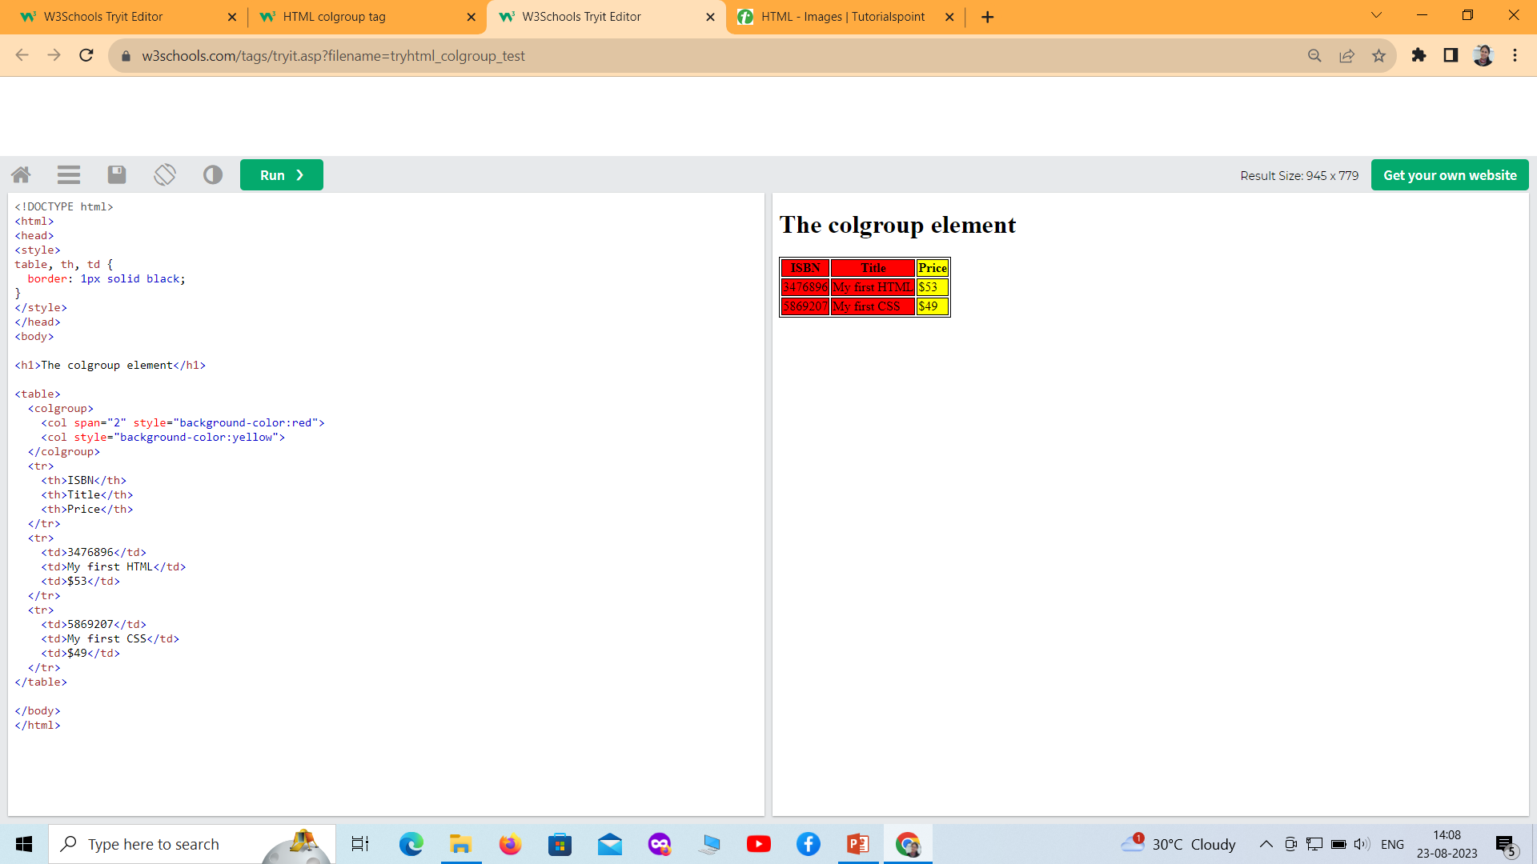

Slide 64
How To Add a Border
To add a border, use the CSS border property on table, th, and td elements:
table, th, td {
border: 1px solid black;
}
Collapse Borders
table, th, td {
border: 1px solid black;
border-collapse: collapse;
}

Slide 65
HTML Table - Cell Padding
Cell padding is the space between the cell edges and the cell content.
By default the padding is set to 0.
To add padding on table cells, use the CSS padding property:
Example
th, td {
padding: 15px;
}

Slide 66
HTML Table - Cell Spacing
Cell spacing is the space between each cell.
By default the space is set to 2 pixels.
To change the space between table cells, use the CSS border-spacing property on the table element:
Example
table {
border-spacing: 30px;
}

Slide 67
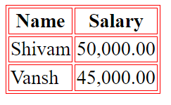
Tables – bordercolor
<html>
<head>
<title>HTML Tables</title> </head>
<body>
<table border="1"bordercolor="red" >
<tr>
  <th>Name</th>
  <th>Salary</th>
</tr>
<tr>
  <td>Shivam</td>
  <td>50,000.00</td>
</tr>
<tr>
  <td>Vansh</td>
  <td>45,000.00</td>
</tr>
</table>
</body>
</html>
we can also set border color also using bordercolor attribute.

Slide 68
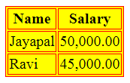
Tables – Backgrounds
Tables Backgrounds
bgcolor attribute − we can set background color for whole table or just for one cell.
background attribute − we can set background image for whole table or just for one cell.
<html>
<head>
<title>HTML Tables</title> </head>
<body>
<table border="1"bgcolor="yellow">
<tr>
  <th>Name</th>
  <th>Salary</th>
</tr>
<tr>
  <td>Jayapal</td>
  <td>50,000.00</td>
</tr>
<tr>
  <td>Ravi</td>
  <td>45,000.00</td>
</tr>
</table>
</body>
</html>

Slide 69
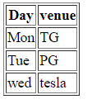
Tables – table body <tbody>
HTML <tbody> tag is used to group the table rows (<tr>) together, which indicates that this is body part of a table (<table>).
The <tbody> tag must be a child of <table> element.
The <tbody> is used along with <thead> and <tfoot> which shows the different part of the table that are table head, table body, and table footer, however, it does not affect the layout of the table.
<!DOCTYPE html>
<html>
<h1>The thead, tbody, and tfoot elements</h1>
<table border="1">
<thead>
<tr>
<th>Day</th>
<th>venue</th>
</tr>
</thead>
<tbody>
<tr>
<td>Mon</td>
<td>TG</td>
</tr>
<tr>
<td>Tue</td>
<td>PG</td>
</tr>
</tbody>
<tfoot>
<tr>
<td>wed</td>
<td>tesla</td>
</tr>
</tfoot>
</table>
</body>
</html>

Slide 70
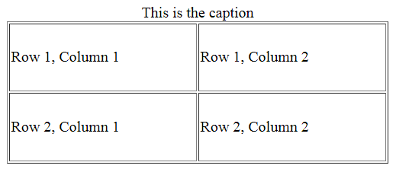
Tables- Height and Width attributes
<html>
<head>
<title>HTML Table Width/Height</title>
</head>
<body>
<table border = "1" width = "400" height = "150">
<caption>This is the caption</caption>
<tr>
<td>Row 1, Column 1</td>
<td>Row 1, Column 2</td>
</tr>
<tr>
<td>Row 2, Column 1</td>
<td>Row 2, Column 2</td>
</tr>
</table>
</body>
</html>
We can set a table width and height using width and height attributes.
Specify table width or height in terms of pixels or in terms of percentage of available screen area.
Table Caption
The caption tag will serve as a title or explanation for the table and it shows up at the top of the table. This tag is deprecated in newer version of HTML/XHTML

Slide 71
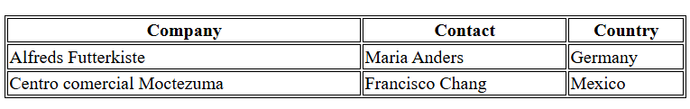
Define an HTML Table
Code:
<table>
<tr>
<th>Company</th>
<th>Contact</th>
<th>Country</th>
</tr>
<tr>
<td>Alfreds Futterkiste</td>
<td>Maria Anders</td>
<td>Germany</td>
</tr>
<tr>
<td>Centro comercial Moctezuma</td>
<td>Francisco Chang</td>
<td>Mexico</td>
</tr>
</table>
Output:

Slide 72
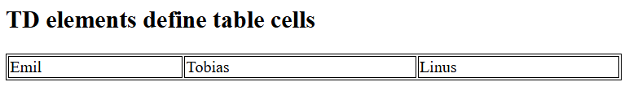
Table Cells
Each table cell is defined by a <td> and a </td> tag.
td stands for table data.
Code:
<table>
<tr>
<td>Emil</td>
<td>Tobias</td>
<td>Linus</td>
</tr>
</table>
Output:

Slide 73

Table Rows
tr stands for table row.
Code:
<table>
<tr>
<td>Emil</td>
<td>Tobias</td>
<td>Linus</td>
</tr>
<tr>
<td>16</td>
<td>14</td>
<td>10</td>
</tr>
</table>
Output:

Slide 74
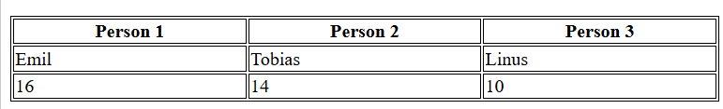
Table Headers
th stands for table header.
Code:
<table>
<tr>
<th>Person 1</th>
<th>Person 2</th>
<th>Person 3</th>
</tr>
<tr>
<td>Emil</td>
<td>Tobias</td>
<td>Linus</td>
</tr>
<tr>
<td>16</td>
<td>14</td>
<td>10</td>
</tr>
</table>
Output:

Slide 75
Table Tags
Tag | Description
<table> | Defines a table
<th> | Defines a header cell in a table
<tr> | Defines a row in a table
<td> | Defines a cell in a table
<caption> | Defines a table caption
<colgroup> | Specifies a group of one or more columns in a table for formatting
<col> | Specifies column properties for each column within a <colgroup> element
<thead> | Groups the header content in a table
<tbody> | Groups the body content in a table
<tfoot> | Groups the footer content in a table

Slide 76
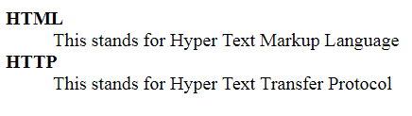
Tags in HTML – Lists (Definition lists)
DEFINITION LISTS
Definition Lists:
HTML supports a list style which is called definition lists where entries are listed like in a dictionary or encyclopedia.
The definition list is the ideal way to present a glossary, list of terms, or other name/value list.
Definition List makes use of following three tags.
1). <dl> - Defines the start of the list
</dl> - Defines the end of the list
2). <dt> - A term
. <dd> - Term definition
<html>
<head>
<title>HTML Definition List</title>
</head>
<body>
<dl>
<dt>HTML</dt>
<dd>This stands for Hyper Text Markup Language</dd>
<dt>HTTP</dt>
<dd>This stands for Hyper Text Transfer Protocol</dd>
</dl>
</body>
</html>

Slide 77
Tags in HTML –Lists
LISTS
  A list is a collection of items.
  HTML offers web authors three ways for specifying lists of information.
  All lists must contain one or more list elements
  Lists are of three types
  1. Un ordered list <ul> Items marked with bullets.
  2. Ordered List <ol> Items marked with numbers or letters
  3. Definition list <dl> Arranges items in the same way as they are arranged in a dictionary.
html
css
javascript
Coffee
Tea
Milk
Coffee
  - black hot drink
Milk
  - white cold drink

Slide 78
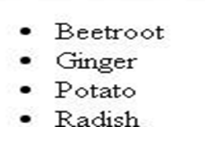
Tags in HTML – Lists (Unordered lists)
LISTS
Unordered Lists :
  An unordered list is a collection of related items that have no special order or sequence.
  This list is created by using HTML <ul> tag.
  Each item in the list is marked with a bullet.
Example
<html>
<head>
<title>HTML Unordered List</title>
</head>
<body>
<ul> <li>Beetroot</li>
<li>Ginger</li>
<li>Potato</li>
<li>Radish</li>
</ul>
</body>
</html>

Slide 79
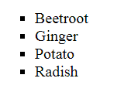
Tags in HTML – Lis
Tags in HTML – Lists (Unordered lists)
UNORDERD LISTS WITH “TYPE” ATTRIBUTE
The type Attribute
we can use type attribute for <ul> tag to specify the type of bullet we like. By default, it is a disc.
Following are the possible options −
  <ul type = "square"> <ul type = "disc"> <ul type = "circle">
Example
<html>
<head> <title>HTML Unordered List</title> </head>
<body>
<ul type = "square">
  <li>Beetroot</li>
  <li>Ginger</li>
  <li>Potato</li>
  <li>Radish</li>
</ul>
</body>
</html>

Slide 80
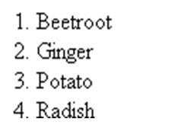
Tags in HTML – Lists (Ordered lists)
ORDERED LISTS
Ordered Lists:-
Items are numbered list instead of bulleted, This list is created by using <ol> tag.
The numbering starts at one and is incremented by one for each successive ordered list element tagged with <li>.
Example
<!DOCTYPE html>
<html>
<head>
<title>HTML Ordered List</title>
</head>
<body>
<ol>
<li>Beetroot</li>
<li>Ginger</li>
<li>Potato</li>
<li>Radish</li>
</ol>
</body>
</html>

Slide 81
Tags in HTML – Lists (Ordered lists)
ORDERED LISTS WITH TYPE ATTRIBURE
The type Attribute:
we can use type attribute for <ol> tag to specify the type of numbering we like. By default, it is a number. Following are the possible options.
  <ol type = "1"> - Default-Case Numerals.
  <ol type = "I"> - Upper-Case Numerals.
  <ol type = "i"> - Lower-Case Numerals.
  <ol type = "A"> - Upper-Case Letters.
  <ol type = "a"> - Lower-Case Letters.
<html>
<head> <title>HTML Ordered List</title> </head> <body>
<ol type = "1">
  <li>Beetroot</li>
  <li>Ginger</li>
  <li>Potato</li>
  <li>Radish</li>
</ol>
</body>
</html>

Slide 82
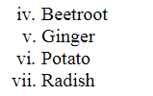
Tags in HTML – Lists (Ordered lists)
ORDERED LISTS WITH “START” ATTRIBURE
The start Attribute
we can use start attribute for <ol> tag to specify the starting point of numbering we need. Following are the possible options −
  <ol type = "1" start = "4"> - Numerals starts with 4.
  <ol type = "I" start = "4"> - Numerals starts with IV.
  <ol type = "i" start = "4"> - Numerals starts with iv.
  <ol type = "a" start = "4"> - Letters starts with d.
  <ol type = "A" start = "4"> - Letters starts with D.
<html>
<head> <title>HTML Ordered List</title> </head>
<body>
<ol type = "i" start = "4">
  <li>Beetroot</li>
  <li>Ginger</li>
  <li>Potato</li>
  <li>Radish</li>
</ol>
</body>
</html>

Slide 83
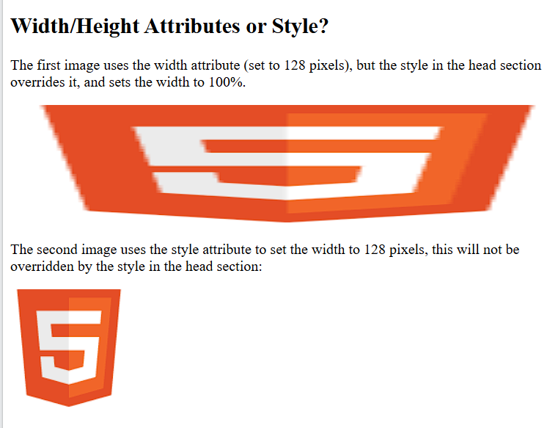
Width and Height, or Style?
<!DOCTYPE html>
<html>
<head>
<style>
/* This style sets the width of all images to 100% */
img {
width: 100%;
}
</style>
</head>
<body>
<h2>Width/Height Attributes or Style?</h2>
<p>
The first image uses the width attribute (set to 128 pixels),
but the style in the head section overrides it, and sets
the width to 100%.
</p>
<img src="html5.gif" alt="HTML5 Icon" width="128" height="128">
<p>
The second image uses the style attribute to set the width
to 128 pixels, this will not be overridden by the style
in the head section:
</p>
<img src="html5.gif"
alt="HTML5 Icon"
style="width:128px;height:128px;">
</body>
</html>
Output:

Slide 84
HTML Audio Tags
The <audio> tag is used to embed audio files in a webpage.
It supports formats like MP3, WAV, and OGG.
Users can play, pause, and control the audio using the controls attribute.
Multiple audio sources can be provided using the <source> tag.
Browsers will play the first supported audio format.
Common Attributes
controls → Displays play/pause and volume controls.
autoplay → Plays audio automatically when the page loads.
loop → Repeats the audio continuously.
muted → Starts the audio in muted mode.

Slide 85
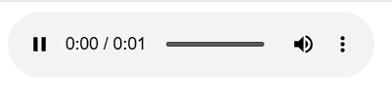
HTML Audio
The HTML <audio> element is used to play an audio file on a web page.
Example:
<audio controls>
<source src="horse.ogg" type="audio/ogg">
<source src="horse.mp3" type="audio/mpeg">
Your browser does not support the audio element.
</audio>
Output:

Slide 86
HTML Audio - How It Works
The controls attribute adds audio controls, like play, pause, and volume.
The <source> element allows you to specify alternative audio files which the browser may choose from. The browser will use the first recognized format.
The text between the <audio> and </audio> tags will only be displayed in browsers that do not support the <audio> element.

Slide 87
HTML Audio Formats
Browser | MP3 | WAV | OGG
Edge/IE | YES | YES* | YES*
Chrome | YES | YES | YES
Firefox | YES | YES | YES
Safari | YES | YES | NO
Opera | YES | YES | YES

Slide 88
HTML Video Tags
The <video> tag is used to embed videos in a webpage.
It supports formats like MP4, WebM, and OGG.
Users can play, pause, adjust volume, and view fullscreen using the controls attribute.
Multiple video sources can be added using the <source> tag.
Browsers play the first supported video format.
Common Attributes
controls → Displays video controls.
width and height → Set the video dimensions.
autoplay → Plays the video automatically.
loop → Repeats the video continuously.
muted → Starts the video without sound.
poster → Displays an image before the video starts playing.

Slide 89
How it Works
The controls attribute displays video controls such as:
  Play
  Pause
  Volume
  Fullscreen
It is recommended to specify the width and height attributes.
Setting width and height prevents the webpage from flickering while the video loads.
The <source> element is used to specify multiple video files.
The browser automatically plays the first supported video format.
Text placed between the <video> and </video> tags is shown only if the browser does not support the <video> element.

Slide 90
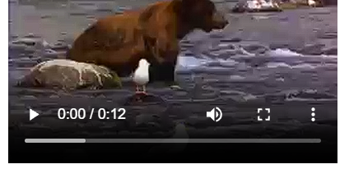
HTML Video
The HTML <video> element is used to show a video on a web page.
Example:
<video width="320" height="240" controls>
<source src="movie.mp4" type="video/mp4">
<source src="movie.ogg" type="video/ogg">
Your browser does not support the video tag.
</video>
Output:

Slide 91
HTML Forms
HTML forms are created using the <form> tag.
Forms are used to collect user input on web pages.
They contain interactive form controls for entering information.
Common form controls include:
  Text fields (<input type="text">)
  Email fields (<input type="email">)
  Password fields (<input type="password">)
  Checkboxes (<input type="checkbox">)
  Radio buttons (<input type="radio">)
  Buttons (<button> or <input type="submit">)
Forms are widely used on websites to collect user data.
More than 85% of websites use forms for user interaction.
Forms allow users to submit data to a web server.
They play an important role in modern web development by enabling user interaction and data collection.

Slide 92
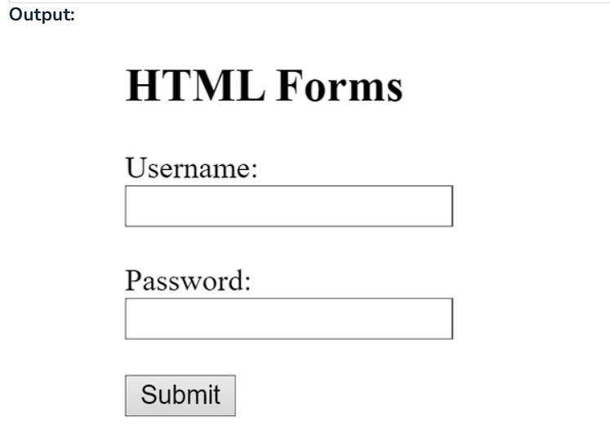
Code
Code:
<!DOCTYPE html>
<html lang="en">
<head>
<meta charset="UTF-8">
<meta name="viewport"
content="width=device-width, initial-scale=1.0">
<title>HTML</title>
</head>
<body>
<h2>HTML Forms</h2>
<form>
<label for="username">Username:</label><br>
<input type="text" id="username" name="username"><br><br>
<label for="password">Password:</label><br>
<input type="password" id="password" name="password"><br><br>
<input type="submit" value="Submit">
</form>
</body>

Slide 93
Form Elements
<label> | It defines labels for <form> elements.
<input> | It is used to get input data from various types such as text, password, email, etc by changing its type.
<button> | It defines a clickable button to control other elements or execute a functionality.
<select> | It is used to create a drop-down list.
<textarea> | It is used to get input long text content.
<fieldset> | It is used to draw a box around other form elements and group the related data.
<legend> | It defines a caption for fieldset elements
<datalist> | It is used to specify pre-defined list options for input controls.
<output> | It displays the output of performed calculations.
<option> | It is used to define options in a drop-down list.
<optgroup> | It is used to define group-related options in a drop-down list.

Slide 94
Input Types in HTML Forms
Input Type | Description
<input type="text"> | Defines a one-line text input field
<input type="password"> | Defines a password field
<input type="submit"> | Defines a submit button
<input type="reset"> | Defines a reset button
<input type="radio"> | Defines a radio button
<input type="email"> | Validates that the input is a valid email address.
<input type="number"> | Allows the user to enter a number. You can specify min, max, and step attributes for range.
<input type="checkbox"> | Used for checkboxes where the user can select multiple options.
<input type="date"> | Allows the user to select a date from a calendar.
<input type="time"> | Allows the user to select a time.
<input type="file"> | Allows the user to select a file to upload.

Slide 95
Form Validation
Form validation ensures that users enter correct and complete data before submitting a form.
It helps prevent invalid or incomplete information.
Validation can be done on the client side (HTML/JavaScript) or server side.
HTML5 provides built-in validation attributes.
Form validation improves data accuracy and user experience.

Slide 96
Validation Attributes
Attribute | Purpose
required | Makes the field mandatory
type="email" | Accepts only valid email addresses
type="number" | Accepts only numeric values
min | Sets the minimum value
max | Sets the maximum value
minlength | Minimum number of characters
maxlength | Maximum number of characters
pattern | Matches a specific format
readonly | Field cannot be edited
disabled | Disables the input field

Slide 97
Definition and Usage Meta tag
The <meta> tag defines metadata about an HTML document.
Metadata means information about the webpage, not the visible content.
The <meta> tag is always placed inside the <head> element.
Metadata is not displayed on the webpage.
It is machine-readable and used by browsers, search engines, and other web services.
The <meta> tag is commonly used to specify:
  Character set (charset)
  Page description
  Keywords
  Author name
  Viewport settings
Browsers use metadata to determine how to display or reload the webpage.
Search engines use metadata such as keywords and descriptions for indexing.
The viewport meta tag helps make webpages responsive on different devices.

Slide 98
HTML <meta> Tag
<head>
<meta charset="UTF-8">
<meta name="description" content="Free Web tutorials">
<meta name="keywords" content="HTML, CSS, JavaScript">
<meta name="author" content="John Doe">
<meta name="viewport" content="width=device-width, initial-scale=1.0">
</head>

Slide 99
HTML Favicon
A favicon is a small icon displayed next to the webpage title in the browser tab.
It helps users identify a website easily among multiple tabs.
The favicon image is commonly named favicon.ico.
Save the favicon:
  In the root directory of the website, or
  Inside an images folder in the root directory.
To add a favicon, use the <link> tag inside the <head> section.
The <link> element is usually placed after the <title> element.
Browsers automatically display the favicon in the browser tab when the page loads.

Slide 100
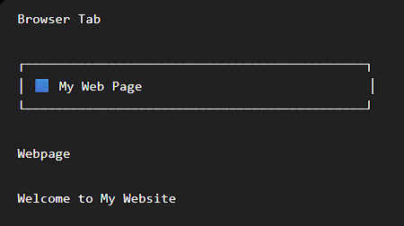
Code
Code:
<!DOCTYPE html>
<html>
<head>
<title>My Web Page</title>
<!-- Favicon -->
<link rel="icon" type="image/x-icon" href="favicon.ico">
</head>
<body>
<h1>Welcome to My Website</h1>
<p>This webpage uses a favicon.</p>
</body>
</html>
Output:
The small icon (🟦 in the example) appears next to the page title in the browser tab. The actual icon depends on the image you use as your favicon.

Slide 101
SEO
SEO (Search Engine Optimization) in Points
SEO stands for Search Engine Optimization.
SEO helps search engines understand your website content.
It also helps users find your website through search engines like Google.
A well-optimized website has a better chance of appearing in search results.
SEO improves a website's visibility and ranking in search engines.
Following Google Search Essentials increases the chances of your website being indexed.
There is no guarantee that a website will rank first on Google.
SEO involves improving a website so that search engines can:
  Crawl the website
  Index the pages
  Understand the content
Good SEO practices make your website more accessible to search engines and users.
SEO is an ongoing process that requires regular improvements and updates.
Best SEO practices benefit all search engines, not just Google.

Slide 102
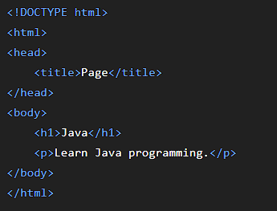
Before SEO
Scenario
A student creates a website about Java programming.
Problems
Generic title ("Page")
No meta description
No keywords
No viewport tag
Difficult for search engines to understand the page

Slide 103
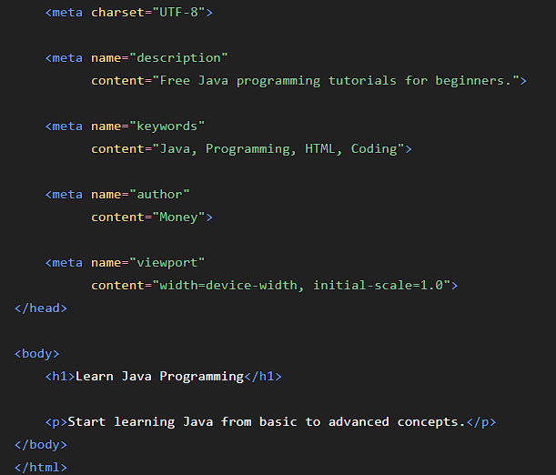
After SEO
Optimized Website

Slide 104
Before VS After
Before SEO | After SEO
Generic title | Descriptive title
No meta description | Meta description added
No keywords | Keywords included
No viewport | Mobile-friendly
Hard to understand | Easy for search engines to understand
Lower visibility | Better search visibility

Slide 105
Benefits of SEO
Increases website visibility
Attracts more visitors (organic traffic)
Improves user experience
Helps search engines understand content
Increases the chances of higher search rankings
Key Point: SEO is the process of optimizing a website so that search engines can crawl, index, understand, and rank it more effectively, making it easier for users to find the website.

Slide 106
Questions
Q1. Which HTML5 semantic element is used to define the main content of a webpage?
A) <header>
B) <main>
C) <footer>
D) <aside>
Answer: B) <main>
Q2. Which HTML attribute is used to make a form field mandatory?
A) required
B) mandatory
C) validate
D) check
Answer: A) required

Slide 107
Conclusion
Summary
HTML5 is the foundation of web development.
Provides semantic elements and multimedia support.
Makes websites more accessible.
Forms and validation improve user experience.
SEO features help websites rank better in search engines.

